Slide 1
What in the world
is going on?

Slide 2
What’s going on in
our own country?

Slide 3
Is God going to
judge America?

Slide 4
How believers
should NOT feel
about what’s
going on?

Slide 5
What believers
should do
about what’s
going on?

Slide 6
2 Timothy 3:1-5 (NKJV) ¹ But know this,
that in the last days perilous
(difficult & dangerous) times will come: ² For men will be lovers of themselves,
lovers of money, boasters, proud,
blasphemers, disobedient to parents,
unthankful, unholy, ³ unloving, unforgiving, slanderers,
without self-control, brutal, despisers of good, ⁴ traitors, headstrong, haughty,
lovers of pleasure rather than lovers of God, ⁵ having a form of godliness
but denying its power.

Slide 7
What in the world
is going on?

Slide 8
35 Percent Increase
in Terrorist Attacks
Worldwide
The U.S. State Department
recently released the Country Reports on Terrorism
finding that nearly 33,000 people were killed
and 34,700 injured in almost 13,500 terrorist attacks
around the world in 2014. That is a 35 percent
increase in terrorist attacks and an 81 percent
increase in total fatalities since 2013.
http://www.nbcnews.com/news/us-news/state-dept-35-percent-increase-terrorist-attacks-worldwide-n378416

Slide 9
World in Crisis,
Most Perilous Time
in World History
“I call now the most perilous time
in world history for good reason.
I was never scared during the Cold War.
For the first time in my life I am now.”
_{-Stephen Lendman}
http://www.globalresearch.ca/world-in-crisis-most-perilous-time-in-world-history-conversation-with-stephen-lendman/5443747

Slide 10
WORLD’S FIRST
THREE-WAY GAY MARRIAGE
TAKES PLACE IN THAILAND
on Valentine’s day 2015
http://www.breitbart.com/national-security/2015/03/05/worlds-first-three-way-gay-marriage-takes-place-in-thailand/

Slide 11
What’s going on in
our own country?

Slide 12
Supreme Court
Declares Nationwide
Right to
Same-Sex Marriage
WASHINGTON — Jun 26, 2015, 4:39 PM ET
http://abcnews.go.com/Politics/wireStory/supreme-court-extends-sex-marriage-nationwide-32048386

Slide 13
From Gay Marriage
to Polygamy?
After the Supreme Court decision in favor of gay marriage,
conservative critics spotted sister wives on the horizon.
Dissenting Chief Justice John Roberts argued that
"much of the majority's reasoning would apply with equal force
to the claim of a fundamental right to plural marriage."
http://www.realclearpolitics.com/articles/2015/07/02/from_gay_marriage_to_polygamy.html

Slide 14
9 dead in shooting
at black church
in Charleston, S.C.
Churches boost security
as violent incidents grow
The number of deadly episodes at sanctuaries has soared
over the last decade, and mass shootings at schools,
malls and movie theaters have left Americans feeling like
it could happen anywhere.
http://www.usatoday.com/story/news/nation/2013/07/07/churches-boost-security-as-violent-incidents-grow/2495241/

Slide 15
School Crime
and Violence Rise
The number of teachers who say they've been
physically attacked by students is the highest yet.
http://www.usnews.com/news/articles/2014/06/10/incidents-of-school-crime-and-violence-on-the-rise-for-students-and-teachers

Slide 16
Mass Shootings
Are Rising
Between 2000 and 2010,
there were as many multi-fatality school shootings
in the United States as there were in China, England,
France, Germany, India, Russia and
30 other countries — combined. Between 1982 and
late 2011, mass shootings occurred about every 200 days.
But after September 2011, the rate of mass shootings
increased to about once every 64 days,
according to the Harvard researchers.
And they can’t explain why.
http://www.forbes.com/sites/dandiamond/2015/06/18/charleston-deaths-are-an-american-tragedy-mass-shootings-are-rising/

Slide 17
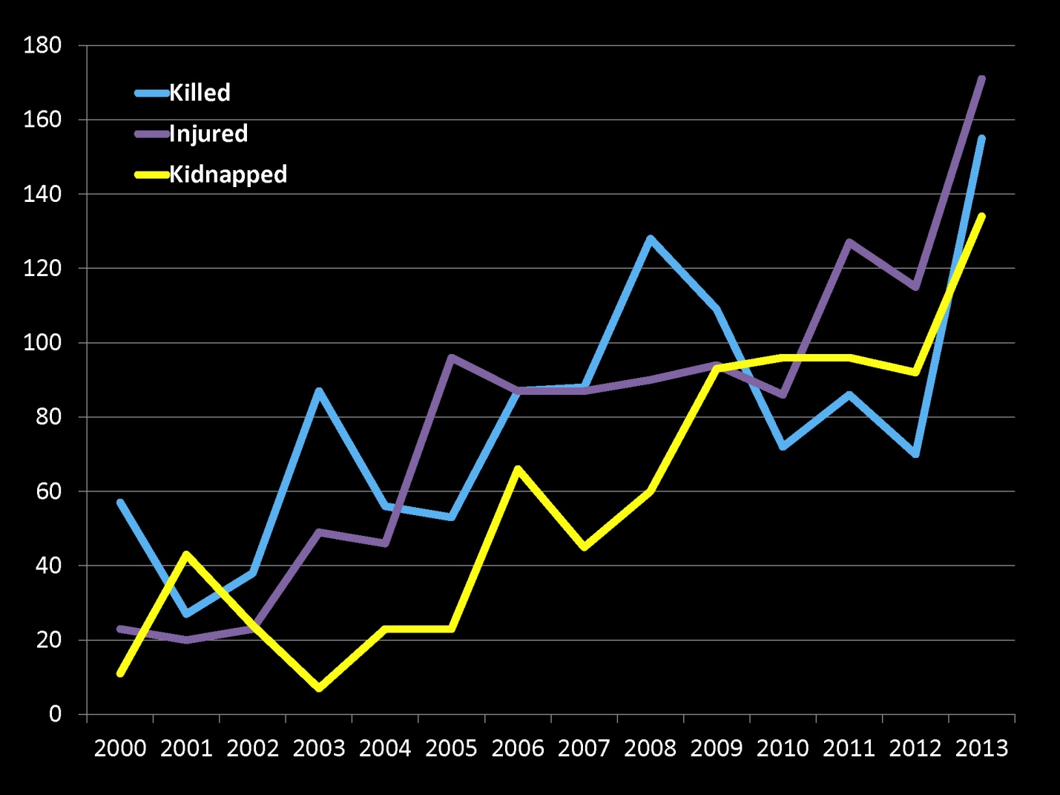

Slide 18
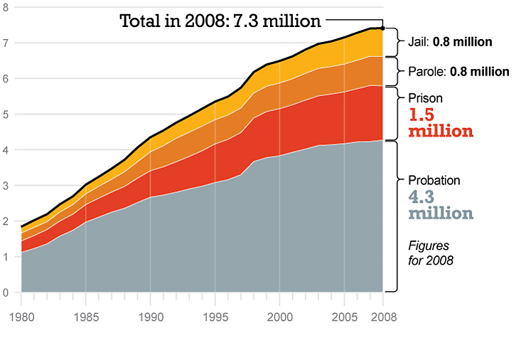
School Crime
and Violence Rise
The number of teachers who say they've been
physically attacked by students is the highest yet.
Since 1980, the U.S. correctional population has nearly quadrupled.
The prison population is up nearly five-fold,
and the jail population is up more than four-fold.

Slide 19
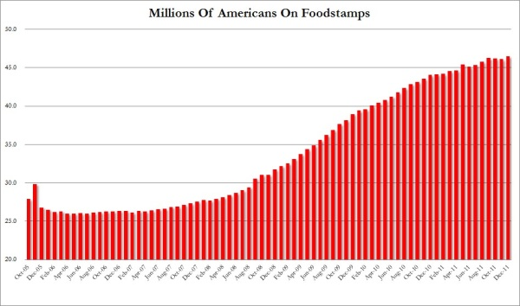
The Rise of Suburban Poverty in America
http://time.com/3060122/poverty-america-suburbs-brookings/

Slide 20
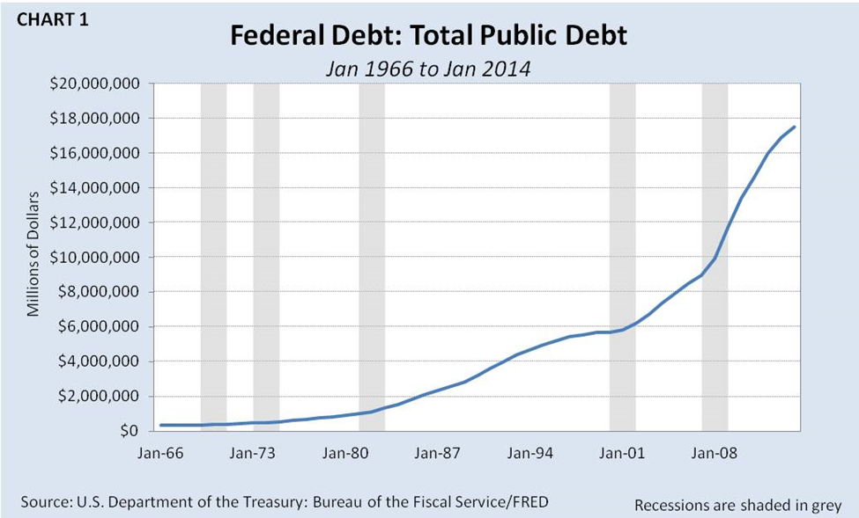

Slide 21
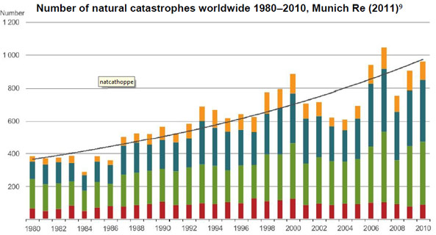
Steady Increase in Climate
Related Natural Disasters
If it feels like there are far more hurricanes and floods these days,
then your instincts are correct. The number of weather related
disasters has increased dramatically in the last 30 years.
http://makewealthhistory.org/2011/05/30/the-number-of-natural-disasters-is-on-the-rise/

Slide 22
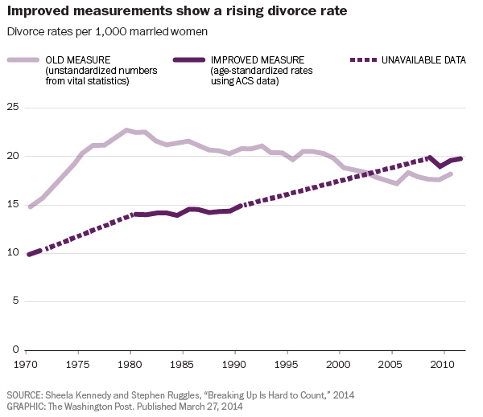

Slide 23
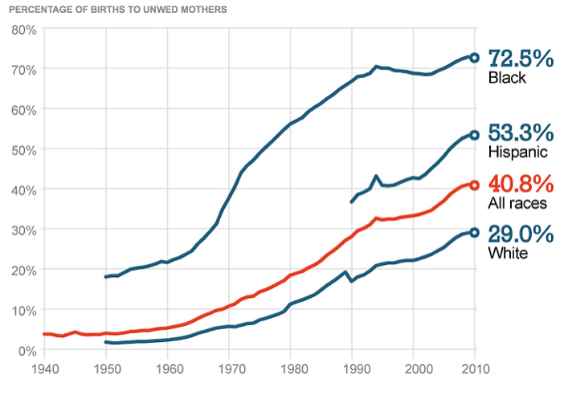

Slide 24
Narcissism Is On
the Rise In America
When tested approximately 70 percent of college students
today score higher on narcissism and lower on empathy
than did the average student thirty years ago.
https://www.psychologytoday.com/blog/freedom-learn/201401/why-is-narcissism-increasing-among-young-americans

Slide 25
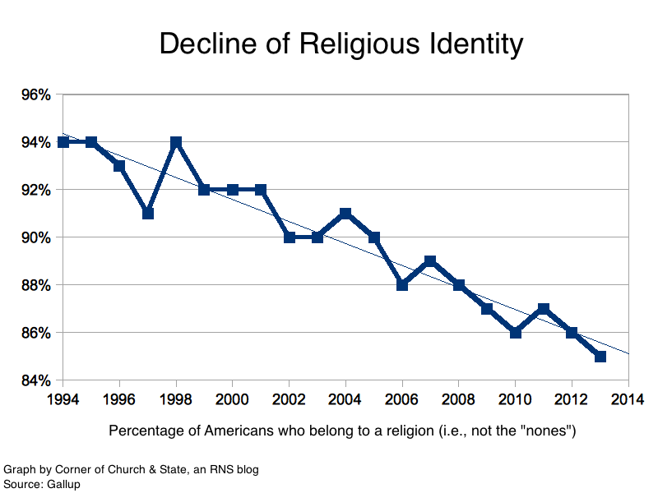

Slide 26
Is God going to
judge America?

Slide 27
Romans 1:18-32 (NKJV) ¹⁸ For the wrath of God is revealed from heaven against all ungodliness and unrighteousness of men, who suppress the truth in unrighteousness, ¹⁹ because what may be known of God is manifest in them, for God has shown it to them. ²⁰ For since the creation of the world His invisible attributes are clearly seen, being understood by the things that are made, even His eternal power and Godhead, so that they are without excuse, ²¹ because, although they knew God, they did not glorify Him as God, nor were thankful, but became futile in their thoughts, and their foolish hearts were darkened. ²² Professing to be wise, they became fools, ²³ and changed the glory of the incorruptible God into an image made like corruptible man--and birds and four-footed animals and creeping things. ²⁴ (1) Therefore God also gave them up to uncleanness, in the lusts of their hearts, to dishonor their bodies among themselves, ²⁵ who exchanged the truth of God for the lie, and worshiped and served the creature rather than the Creator, who is blessed forever. Amen. ²⁶ (2) For this reason God gave them up to vile passions. For even their women exchanged the natural use for what is against nature. ²⁷ Likewise also the men, leaving the natural use of the woman, burned in their lust for one another, men with men committing what is shameful, and receiving in themselves the penalty of their error which was due. ²⁸ And even as they did not like to retain God in their knowledge, (3) God gave them over to a debased mind, to do those things which are not fitting; ²⁹ being filled with all unrighteousness (wrongdoing), sexual immorality, wickedness (depravity), covetousness (materialism), maliciousness (badness); full of envy, murder, strife (fighting), deceit (dishonesty), evil-mindedness (bad-character); they are whisperers (people who ENJOY spreading rumors), ³⁰ backbiters (slanderers), haters of God, violent, proud, boasters, inventors of evil things, disobedient to parents, ³¹ undiscerning, untrustworthy, unloving, unforgiving, unmerciful; ³² who, knowing the righteous judgment of God, that those who practice such things are deserving of death, not only do the same but also approve of those who practice them.

Slide 28
How believers
should NOT feel
about what’s
going on?

Slide 29
Don’t Be Afraid
Don’t Be Angry
Don’t Be Indifferent
The first thing is to understand that this rampant
and largely accepted growth of immorality, rebellion and
secularization of a people group is nothing new historically.
There have been periods throughout History where
this theme of growing immorality, rebellion
and secularization has taken place.

Slide 30
Don’t Be Afraid
2 Peter 2:4-9 (NKJV)

Slide 31
Don’t Be Angry
Psalm 37:8-11 (NKJV)

Slide 32
Don’t Be Indifferent
Revelation 3:15-16 (NKJV)

Slide 33
What believers
should do
about what’s
going on?

Slide 34
See it for what it is
Pray, Read, Fellowship
Remember who you are

Slide 35
See it for what it is

Slide 36
Pray, Read, Fellowship

Slide 37
Remember who you are
You Are Salt
You Are LIGHT

Slide 38
Remember who you are
Let your light so shine before men,
that they may see your good works
and glorify your Father in heaven.

